Slide 1
The Assassination of Franz Ferdinand
Franz Ferdinand was the heir to the throne of Austria-Hungary. On June 28, 1914 he paid a royal visit to the Bosnian city of Sarajevo. Austria-Hungary had angered many people in the Balkans (especially Serbs) by annexing Bosnia in 1908. June 28 was also an important day for Serbs, as it commemorated a 14th century battle against the Ottoman Empire. Many Serbs thus saw the archduke’s visit as an insult. His security team knew that there were dangers in the visit, but they went ahead with it anyway.

Slide 2
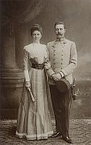
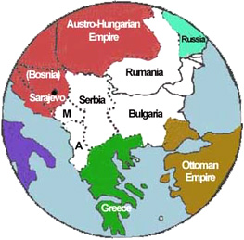
http://www.radio.cz/en/section/mailbox/mailbox-2008-03-02
http://users.humboldt.edu/ogayle/hist111/BalanceofPower.html
Notes:
Sunday, June 28th, 1914, was a bright and sunny day in Sarajevo. Sarajevo was located in the disputed territory of Bosnia. Both the Austro-Hungarian Empire and Serbia wanted this territory.
The future king of Austria, Archduke Franz Ferdinand and his wife, Sophie, visited Sarajevo. This visit in part would demonstrate that the Archduke and his family had control over the area. When it was learned that Ferdinand would visit Sarajevo, a group of terrorists called the Black Hand decided to assassinate him. If Ferdinand were assassinated, Bosnia might be able to join Serbia and form a new state. On June 28th, six teenage assassins waited among the crowds that lined the streets to watch the royal procession. The Archduke and his wife rode in an open topped vehicle. The first two assassins lost their nerve and let the car pass.

Slide 3
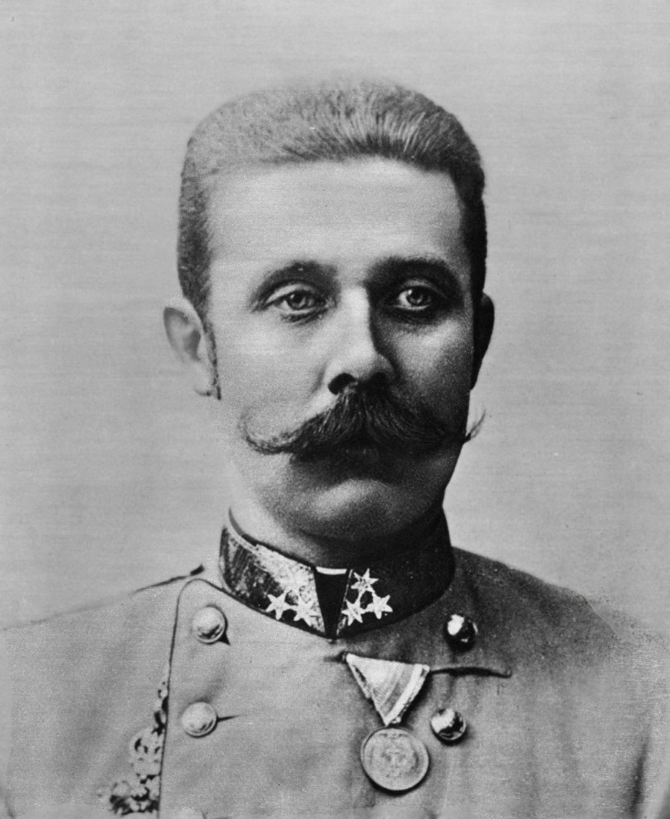
The Archduke
Ironically, Franz Ferdinand advocated giving the Slavs inside the Austro-Hungarian Empire more political power. Many people who knew him had a low opinion of him, although Kaiser Wilhelm II of Germany and Austro-Hungarian General Franz Conrad von Hötzendorff thought highly of him.
http://commons.wikimedia.org/wiki/File:Franz_ferdinand_bw.jpg

Slide 4
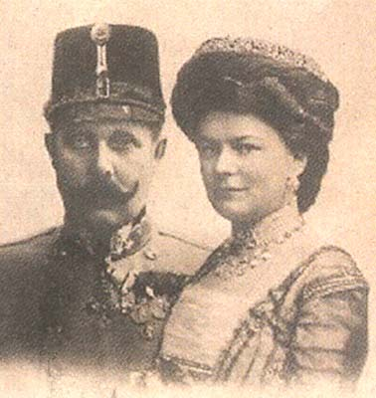
His Family
The archduke married for love, taking a wife who was aristocratic but not of royal blood. Most members of the Austro-Hungarian court hated Sophie and treated the couple rudely. As a condition for the emperor’s approval of the marriage, Franz Ferdinand had to agree that any children he and Sophie had would not succeed him. Sophie died by the same assassin’s hand as her husband.
http://www.radio.cz/en/section/curraffrs/descendant-of-franz-ferdinand-of-austria-claims-back-konopiste-castle

Slide 5
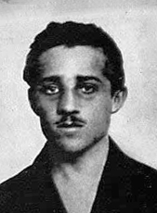
The Assassination
The assassination was well planned. The first attempt, however, failed. Later in the day, the archduke’s driver made a wrong turn. He came to a stop right near Gavrilo Princip, a teenager involved in the plot. Princip fired his pistol into the car killing the Archduke and Sophie.
http://upload.wikimedia.org/wikipedia/commons/8/8d/Gavrilo_Princip_cropped.jpg

Slide 6
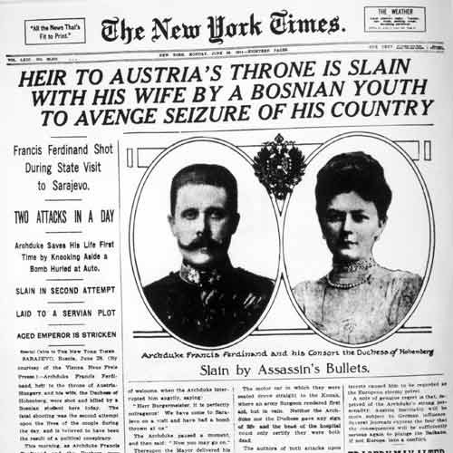
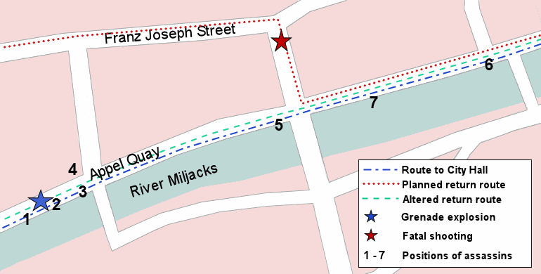
http://www.assassinationinfo.com/Assassinations/Franz_Ferdinand/events.htm
http://news.ca.msn.com/9-11-anniversary/worst-terrorist-attacks-in-history?page=8
Notes:
The third assassin threw a bomb at the car, but the Archduke saw it coming and threw it off his vehicle. It exploded under the car behind him, injuring several people. The Archduke’s driver sped away, fearing more bombs. The other assassins assumed the explosion meant the Archduke had been killed. They left the scene, with the exception of Gavrilo Princip, who soon learned the truth. Upset that the assassination plot had failed, Princip wandered across the street towards a café. He was standing outside the café when the Archduke’s driver made a wrong turn. Princip found himself only a few feet from the car. He pulled a pistol from his coat pocket and fired two shots at close range. He hit Ferdinand with one bullet, and the other ricocheted off the car and hit Sophie. Both died approximately fifteen minutes later.

Slide 7
“I am not a criminal, because I destroyed that which was evil. I think that I am good.”
-Gavrilo Princip
October 12, 1914
http://en.wikipedia.org/wiki/Gavrilo_Princip
http://www.ucis.pitt.edu/eehistory/H200Readings/Topic6-R3.html
Notes:
“I am not a criminal because I destroyed that which was evil. I think that I am good.” These were the words spoken by Gavrilo Princip at his trial in October of 1914, almost four months after he assassinated Austrian Archduke Franz Ferdinand and his wife, Sophie, during a visit to Sarajevo. By the time Princip faced trial, Europe had been at war for two months.

Slide 8
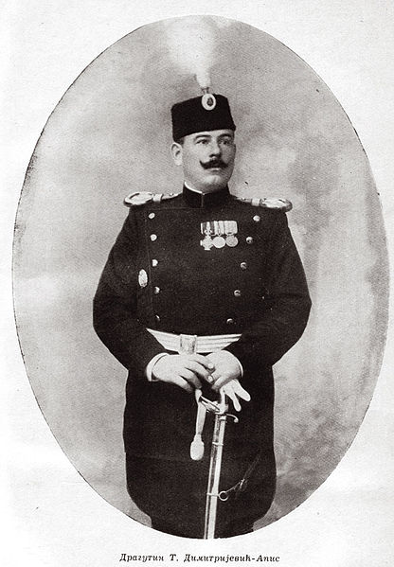
Was Serbia Involved?
The evidence remained inconclusive in the summer of 1914, but we now know that a Serbian Army officer named Dragutin Dimitrijević was deeply involved. Known as Apis, he and two colleagues trained the assassins and planned the attack. Apis was a violent man who had been involved in several anti-Austrian plots and had played a key role in the violent overthrow of the Serbian royal family in 1903.
http://upload.wikimedia.org/wikipedia/commons/thumb/c/cc/Dragutin_dimitrijevic_apis.jpg/416px-Dragutin_dimitrijevic_apis.jpg

Slide 9
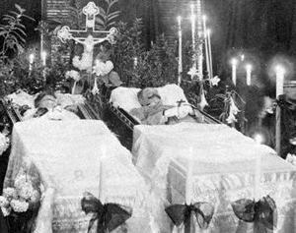
The European Reaction
Few people thought the archduke’s death would lead to war. They expected that Austria-Hungary would demand to know how deeply involved the Serbian government might have been. If the government was involved, then Austria-Hungary could demand some sort of financial or territorial compensation from Serbia. Almost no one thought that a general war would follow.
The couple had a non-royal burial that none of the European heads of state attended. The low-key ceremony led people to think that the assassination would not lead to further trouble.
http://www.theroyalarticles.com/content_images/4/Archduke-Archduchess%20of%20Austria-Hungary.jpg

